Slide 1
Amazon Music Clustering 🎧
Unsupervised Machine Learning Project
Presented by: Supriya Mishra
Key Skills: Python, Scikit-Learn, K-Means, Streamlit.

Slide 2
Problem Statement & Business Use Cases
The Problem: Amazon Music has millions of songs. Manually tagging genres is slow, subjective, and impractical.
The Solution: Use Machine Learning to "listen" to audio features and group songs automatically.
Use Cases:
Personalized Playlists: Creating mood-based sets (e.g., "Deep Focus").
Song Discovery: Suggesting tracks with similar "audio fingerprints.”
Market Analysis: Identifying gaps in the music library.

Slide 3
Data Preprocessing & Feature Engineering
Dataset: Amazon Music audio features (Danceability, Energy, Tempo, etc.).
Cleaning: Handled missing values and dropped non-numeric metadata.
Scaling (Crucial Step): Used StandardScaler to normalize data.
Why? To ensure high-value features (like Tempo) don't overpower low-value ones
(like Danceability).
Features Selected: 10 key audio characteristics that define a song’s "sound”.

Slide 4
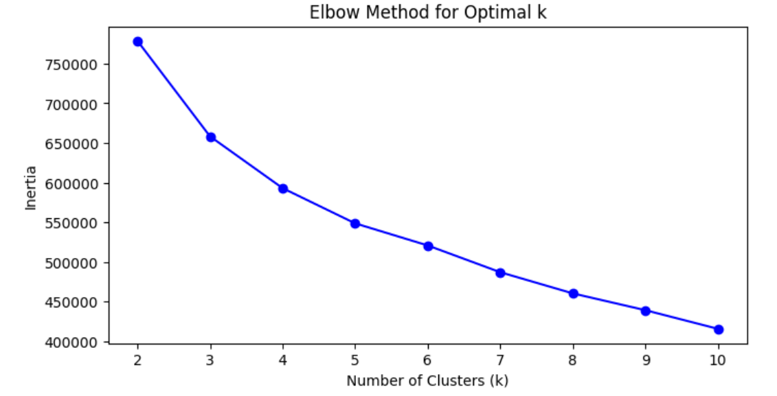
Finding the Optimal Clusters (The Elbow Method)
Method: Ran K-Means for k=2 to k=10.
The Decision: Chose \(k=5\) as the "Elbow Point" where the rate of improvement (Inertia) began to level off.
Evaluation: Validated the clusters using the Silhouette Score.

Slide 5
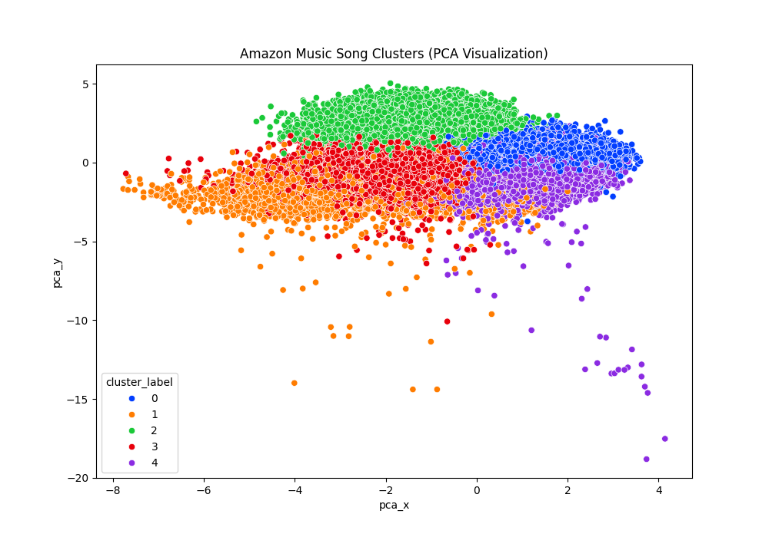
Visualizing the Clusters (PCA)
The Challenge: We can't visualize 10 dimensions at once.
The Solution: Used Principal Component Analysis (PCA) to squash data into 2D.
Insight: The clear separation between colors proves the model successfully found distinct patterns in the music.

Slide 6
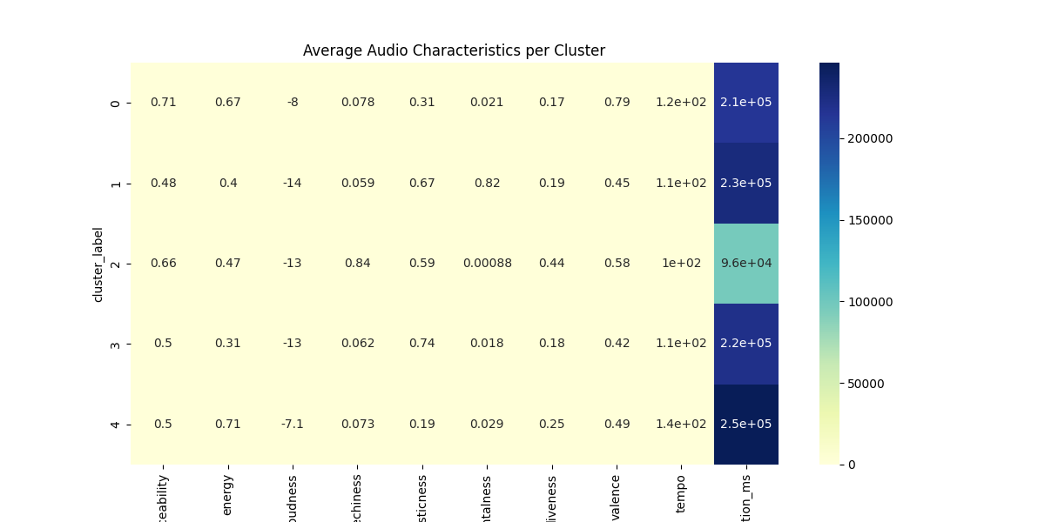
Musical Fingerprints (Cluster Analysis)
The Story (Labels):
Cluster 0: Feel-Good Hits (High Valence/Energy).
Cluster 1: Instrumental/Chill (High Instrumentalness).
Cluster 2: Spoken Word (High Speechiness/Short Duration).
Cluster 3: Soft Acoustic (High Acousticness).
Cluster 4: High Energy (High Tempo/Loudness).

Slide 7
Conclusion & Demo
Summary: Built an end-to-end pipeline from raw data to a functional clustering model.
Bonus Deliverable: Interactive Streamlit App for real-time cluster exploration.
Future Scope: Integrate this model into a real-time recommendation engine.
Call to Action: "Let's move to the Live Demo of the Streamlit App."

